Slide 1

The Roentgen, the Rad, and the Rem
And the sievert, the gray, and the… paperclip?

Slide 2
Learning Objectives:
Define Dosimetry and how dosimetric approaches changed over time
Understand and convert between eXposure, absorbed Dose, and Kerma
Calculate X, D, and K given fluence, energy, and appropriate material properties
Understand and utilize the Bragg-Gray Principle to calculate D to a material given the absorbed dose in a cavity
Perform basic internal dosimetry calculations utilizing dose conversion factors for inhalation and ingestion

Slide 3
Dosimetry Definition
Dosimetry is “…the methods, measurements, and calculations involved in evaluating the ionizing radiation absorbed by a target”
  Often a human
  Sometimes a material
Notes:
Because radiation is undetectable to the human senses, it is a challenging hazard to quantify. Thus, dosimetry is…
Typically a human body
Sometimes a material – electronics and structural steel

Slide 4
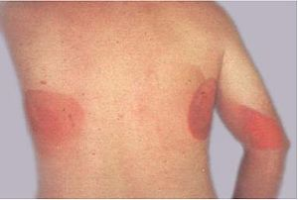
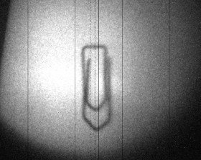
Historical Units
Early units are tied to clearly visible effects:
The Skin-Erythema Unit:
  The dose required to incite a mild radiation burn on the skin
  Still a real unit you can calculate at a tanning salon ☺
The Paperclip
  Radiation required to create a shadow on a photoplate
Notes:
Early units based on what we have access to use for detection
The skin: SEU
The paperclip: Photoplates

Slide 5
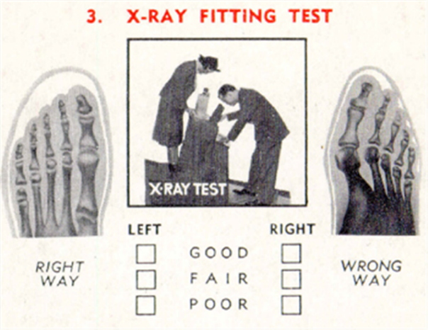

Principle of Initial Radiation Standards
The early limits on exposure to x-rays were a judgment call based on absence of observed acute harm (i.e. burns). They were not arrived at through quantitative observation of biological changes
Environmental engineers, this should sound familiar…
Notes:
Early on, we presumed safe until proven dangerous. Thus, if we didn’t notice any harm, we assumed there wasn’t any.
X-ray fitting for shoes until the 1970’s(!!!)
Comparable to DDT

Slide 6
The Modern Approach
The modern approach has been to rely on risk estimates that are unlikely to underestimate the long-term consequences of radiation exposure, such as cancers
It is important to realize that most of the harmful effects observed in human populations have occurred at high doses and high dose rates.
  Largest epidemiological studies are from Hiroshima and Nagasaki
The information gathered from those populations must then be extrapolated to low doses and low dose rates to estimate the risks that occur in occupational/public health settings.
Notes:
Modern approaches focus on long-term effects
Most of those effects are truly attributable only at high doses/dose rates, so most data from very quickly exposed populations
Need to extrapolate down

Slide 7
Dosimetry Concepts and Units

Slide 8
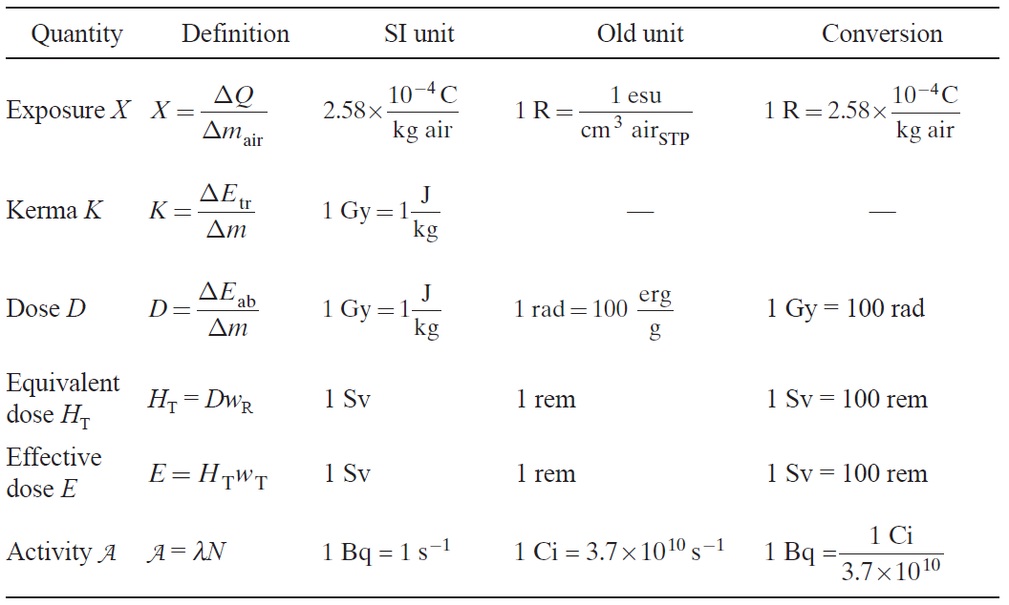
Notes:
Only units in red for today

Slide 9
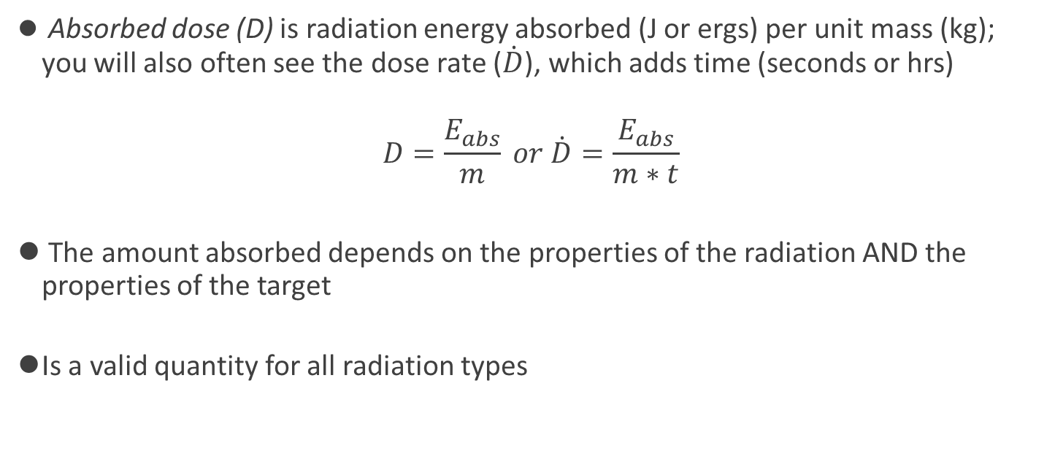
Absorbed Dose
Absorbed dose (D) is radiation energy absorbed (J or ergs) per unit mass (kg); you will also often see the dose rate ($\dot{D}$), which adds time (seconds or hrs)
$$D=\frac{E_{abs}}{m} or \dot{D}=\frac{E_{abs}}{m∗t}$$
The amount absorbed depends on the properties of the radiation AND the properties of the target
Is a valid quantity for all radiation types
Notes:
The most literal unit we will talk about today -

Slide 10
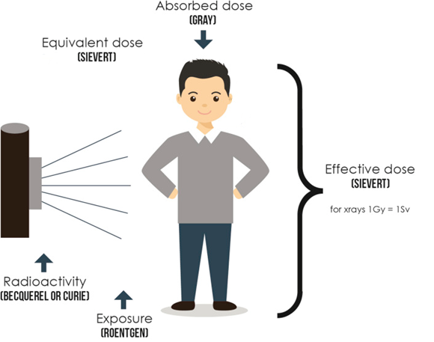



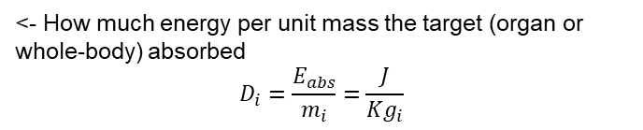
<- How much energy per unit mass the target (organ or whole-body) absorbed
$$D_{i}=\frac{E_{abs}}{m_{i}}=\frac{J}{Kg_{i}}$$
How damaging the type of radiation is
$$H=D∗W_{R}$$
$$W_{R}>1 for α,η$$
$$W_{R}=1 for γ, β$$
Total effective biological damage, based on absorbed dose, radiation type, and target organ
$$E_{T}=D_{T}∗W_{R}∗W_{T}$$
$$E_{total}=∑(E_{T})$$
Measure of how much radioactive material is present
$$1 Roentgen=100\frac{ergs}{g air_{STP}}, 1 X\text{−}unit is 1\frac{C}{kg air_{STP}}$$
^ “Objective” measure of radiation produced, independent of target

Slide 11
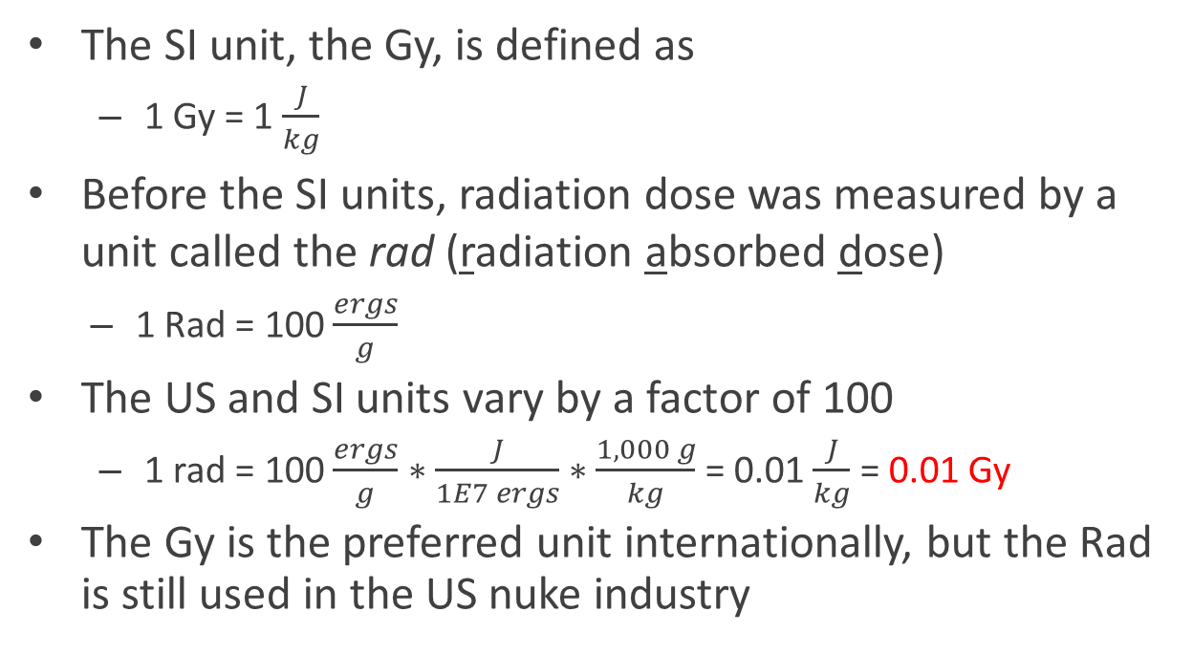
Absorbed Dose Units
The SI unit, the Gy, is defined as
  1 Gy = 1 $\frac{J}{kg}$
Before the SI units, radiation dose was measured by a unit called the rad (radiation absorbed dose)
  1 Rad = 100 $\frac{ergs}{g}$
The US and SI units vary by a factor of 100
  1 rad = 100 $\frac{ergs}{g}$ $∗\frac{J}{1E7 ergs}∗\frac{1,000 g}{kg}$ = 0.01 $\frac{J}{kg}$ = 0.01 Gy
The Gy is the preferred unit internationally, but the Rad is still used in the US nuke industry

Slide 12
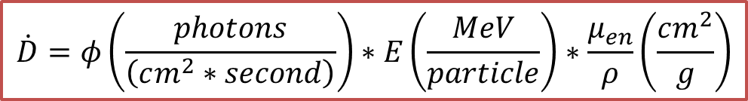
Absorbed Dose from Flux
A General form of the absorbed dose rate equation is
$$\dot{D}=φ\left(\frac{photons}{\left(cm^{2}∗second\right)}\right)∗E\left(\frac{MeV}{particle}\right)∗\frac{μ_{en}}{ρ}\left(\frac{cm^{2}}{g}\right)$$
What are the output units if you use the values given above? How could you convert to the Gy or the Rad?

Slide 13

Consider a 0.3 MeV gamma ray beam with a photon flux of 1000 photons/cm²/s.
Given the absorbed dose rate equation from earlier and ${\left(\frac{μ_{en}}{ρ}\right)}_{tissue}^{300keV}=3.164E\text{−}2\frac{\left(cm^{2}\right)}{g},$ what is what is the absorbed dose rate for soft tissue?
First Principles Absorbed Dose Calculation

Slide 14
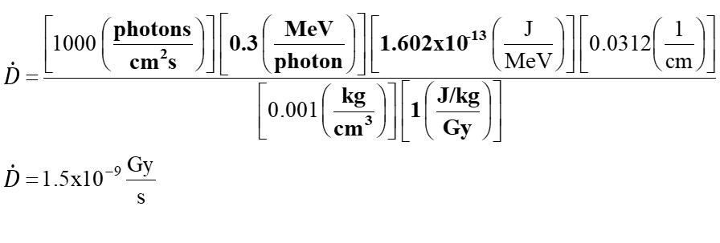
First Principles Absorbed Dose Solution

Slide 15
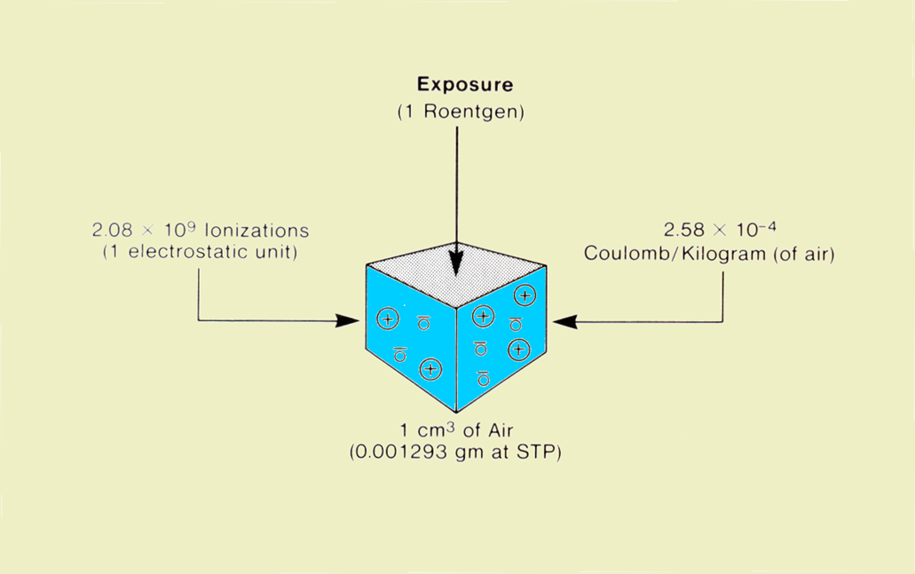
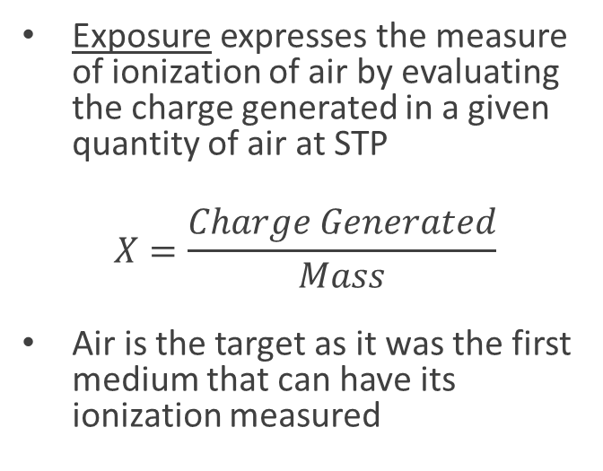
Exposure
Exposure expresses the measure of ionization of air by evaluating the charge generated in a given quantity of air at STP
$$X=\frac{Charge Generated}{Mass}$$
Air is the target as it was the first medium that can have its ionization measured

Slide 16


<- How much energy per unit mass the target (organ or whole-body) absorbed
$$D_{i}=\frac{E_{abs}}{m}$$
How damaging the type of radiation is
$$H=D∗W_{R}$$
$$W_{R}>1 for α,η$$
$$W_{R}=1 for γ, β$$
$$X=\frac{q}{m_{air}}$$
^ “Objective” measure of a radiation field, defined as charge produced in air at STP

Slide 17
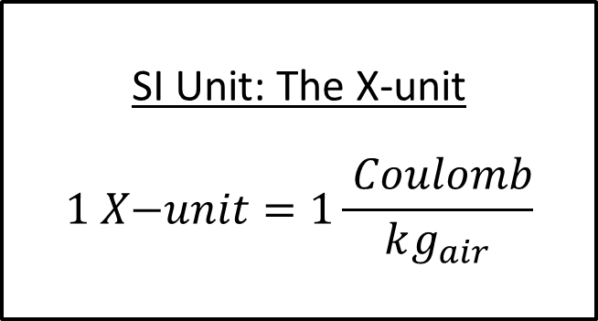
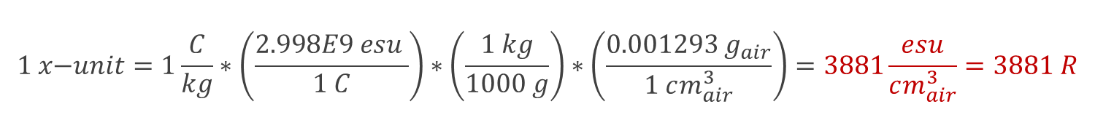
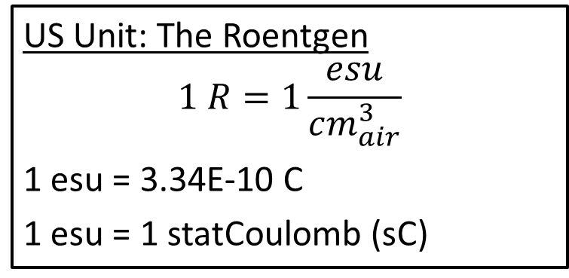
Exposure Units
SI Unit: The X-unit
$$1 X\text{−}unit=1\frac{ Coulomb}{kg_{air}}$$
US Unit: The Roentgen
$$1 R=1\frac{esu}{cm_{air}^{3}}$$
1 esu = 3.34E-10 C
1 esu = 1 statCoulomb (sC)
$$1 x\text{−}unit=1\frac{C}{kg}∗\left(\frac{2.998E9 esu }{1 C}\right)∗\left(\frac{1 kg}{1000 g}\right)∗\left(\frac{0.001293 g_{air}}{1 cm_{air}^{3}}\right)=3881\frac{esu}{cm_{air}^{3}}=3881 R$$
Conversion:

Slide 18
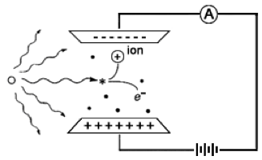
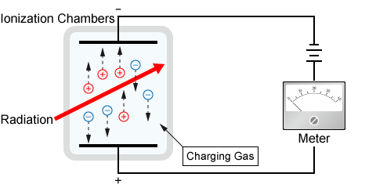
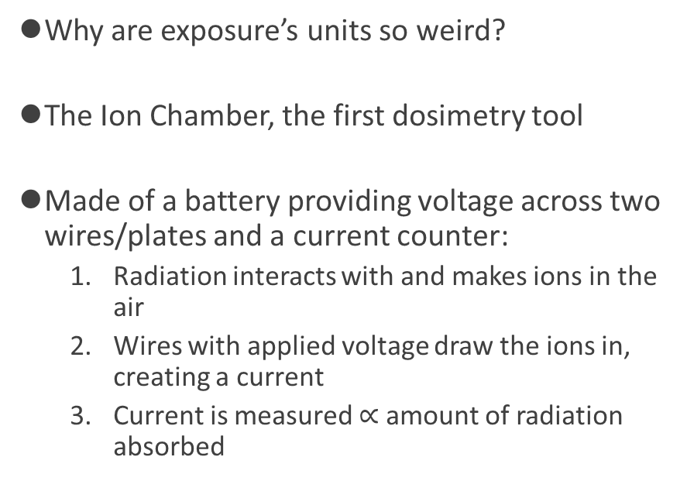
Measuring Exposure
Why are exposure’s units so weird?
The Ion Chamber, the first dosimetry tool
Made of a battery providing voltage across two wires/plates and a current counter:
  Radiation interacts with and makes ions in the air
  Wires with applied voltage draw the ions in, creating a current
  Current is measured $∝$ amount of radiation absorbed

Slide 19
Exposure to Air Dose
X-units can also be converted into more fundamental units of absorbed dose, given:
  the charge on a single ion pair is 1.6 X 10⁻¹⁹ C
  the average energy dissipated per ion pair produced in air is 34 eV
Notes:
Remember to point out that an ion pair is actually saying an elementary charge

Slide 20
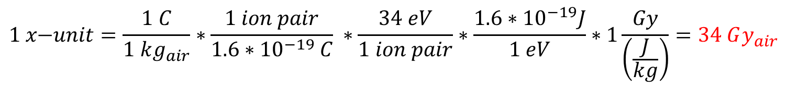
Exposure to Air Dose
X-units can also be converted into more fundamental units of absorbed dose, given:
  the charge on a single ion pair is 1.6 X 10⁻¹⁹ C
  the average energy dissipated per ion pair produced in air is 34 eV
$$1 x\text{−}unit=\frac{1 C}{1 kg_{air}}∗\frac{1 ion pair}{1.6∗{10}^{−19} C} ∗\frac{34 eV}{1 ion pair}∗\frac{1.6∗{10}^{−19}J}{1 eV}∗1\frac{Gy}{\left(\frac{J}{kg}\right)}=34 Gy_{air}$$
If you repeat this for the US units: $1 R=0.877 ra{ds}_{air}$
Notes:
Remember to point out that an ion pair is actually saying an elementary charge

Slide 21
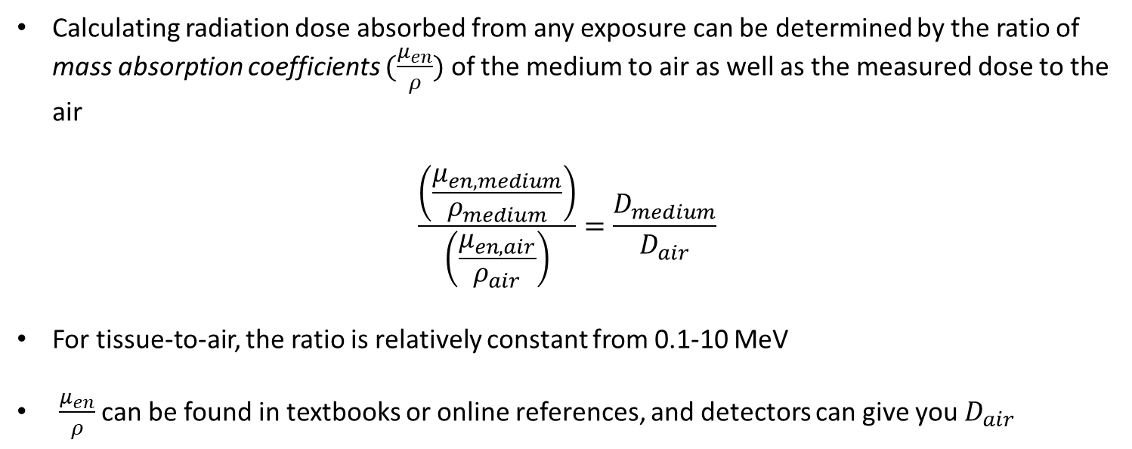
Exposure to Material Dose: Comparative Method
Calculating radiation dose absorbed from any exposure can be determined by the ratio of mass absorption coefficients $(\frac{μ_{en}}{ρ})$ of the medium to air as well as the measured dose to the air
$$\frac{\left(\frac{μ_{en,medium}}{ρ_{medium}}\right)}{\left(\frac{μ_{en,air}}{ρ_{air}}\right)}=\frac{D_{medium}}{D_{air}}$$
For tissue-to-air, the ratio is relatively constant from 0.1-10 MeV
$\frac{μ_{en}}{ρ}$ can be found in textbooks or online references, and detectors can give you $D_{air}$
Notes:
For a given mass of both materials, the ratio of absorbed doses

Slide 22
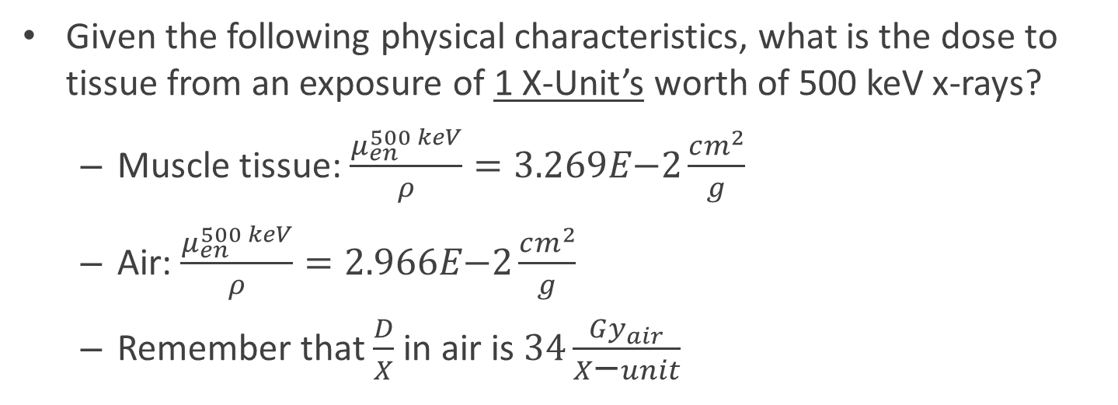
Comparative Method Example
Given the following physical characteristics, what is the dose to tissue from an exposure of 1 X-Unit’s worth of 500 keV x-rays?
  Muscle tissue: $\frac{μ_{en}^{500 keV}}{ρ}=3.269E\text{−}2\frac{cm^{2}}{g}$
  Air: $\frac{μ_{en}^{500 keV}}{ρ}=2.966E\text{−}2\frac{cm^{2}}{g}$
  Remember that $\frac{D}{X}$in air is $34\frac{Gy_{air}}{X\text{−}unit}$

Slide 23

We are given:
  ${\left(\frac{μ_{en}^{500 keV}}{ρ}\right)}_{muscle}=3.269E\text{−}2\frac{cm^{2}}{g}$
  ${\left(\frac{μ_{en}^{500 keV}}{ρ}\right)}_{air} =2.966E\text{−}2\frac{cm^{2}}{g}$
  X = 1 x-unit

Slide 24
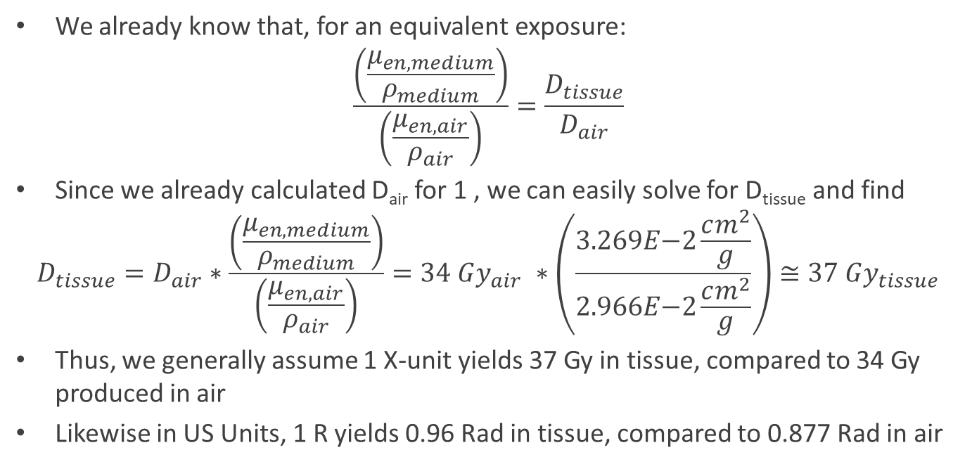
Comparative Method Solution
We already know that, for an equivalent exposure:
$$\frac{\left(\frac{μ_{en,medium}}{ρ_{medium}}\right)}{\left(\frac{μ_{en,air}}{ρ_{air}}\right)}=\frac{D_{tissue}}{D_{air}}$$
Since we already calculated D_{air} for 1 , we can easily solve for D_{tissue} and find
$$D_{tissue}=D_{air}∗\frac{\left(\frac{μ_{en,medium}}{ρ_{medium}}\right)}{\left(\frac{μ_{en,air}}{ρ_{air}}\right)}=34 Gy_{air} ∗\left(\frac{3.269E\text{−}2\frac{cm^{2}}{g}}{2.966E\text{−}2\frac{cm^{2}}{g}}\right)≅37 Gy_{tissue}$$
Thus, we generally assume 1 X-unit yields 37 Gy in tissue, compared to 34 Gy produced in air
Likewise in US Units, 1 R yields 0.96 Rad in tissue, compared to 0.877 Rad in air

Slide 25
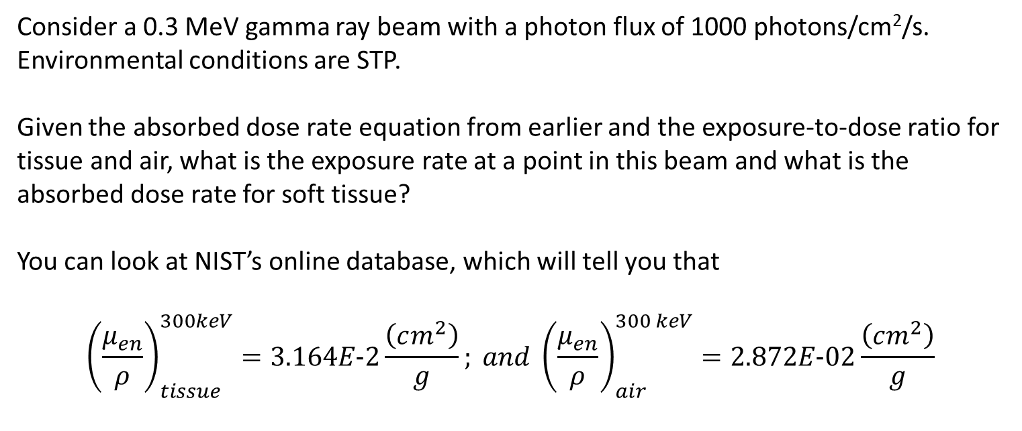

Consider a 0.3 MeV gamma ray beam with a photon flux of 1000 photons/cm²/s. Environmental conditions are STP.
Given the absorbed dose rate equation from earlier and the exposure-to-dose ratio for tissue and air, what is the exposure rate at a point in this beam and what is the absorbed dose rate for soft tissue?
You can look at NIST’s online database, which will tell you that
$${\left(\frac{μ_{en}}{ρ}\right)}_{tissue}^{300keV}=3.164E\text{−}2\frac{\left(cm^{2}\right)}{g}; and {\left(\frac{μ_{en}}{ρ}\right)}_{air}^{300 keV}=2.872E\text{−}02\frac{\left(cm^{2}\right)}{g}$$
First Principles Exposure Calculation
$$\dot{D}=φ∗E∗\frac{μ_{en}}{ρ}$$

Slide 26
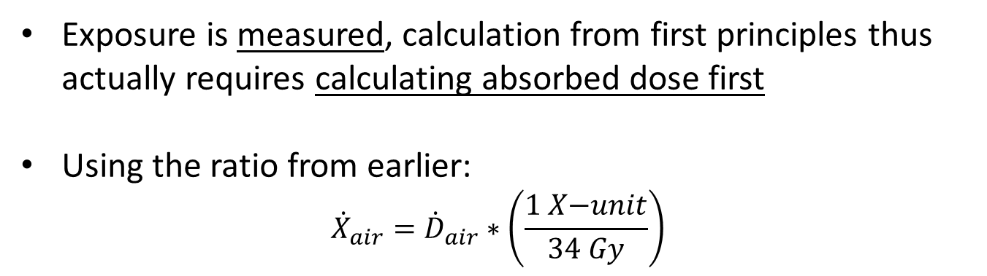
First Principles Exposure Calculation
Exposure is measured, calculation from first principles thus actually requires calculating absorbed dose first
Using the ratio from earlier:
$${\dot{X}}_{air}={\dot{D}}_{air}∗\left(\frac{1 X\text{−}unit}{34 Gy}\right)$$

Slide 27
First Principles Exposure Calculation
$$\dot{X}=φ\left(\frac{photons}{cm^{2}∗second}\right)∗E\left(\frac{MeV}{particle}\right)∗1.602E\text{−}13\left(\frac{J}{MeV}\right)∗\frac{μ_{en}}{ρ}\left(\frac{cm^{2}}{g}\right)∗34\frac{Gy}{X\text{−}unit}$$

Slide 28
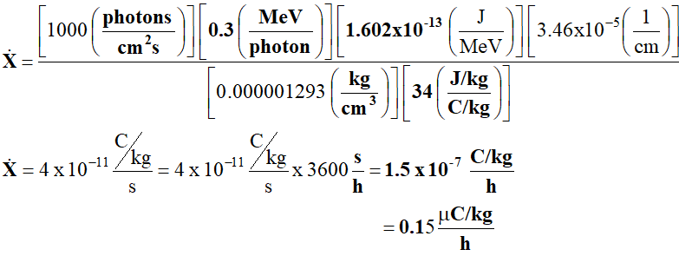
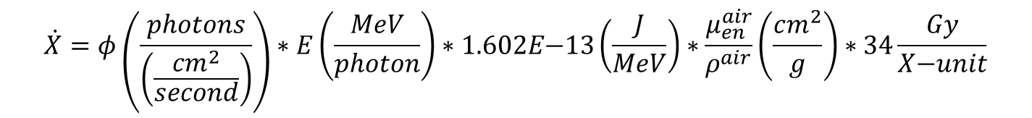
First Principles Exposure Calculation
$$\dot{X}=φ\left(\frac{photons}{\left(\frac{cm^{2}}{second}\right)}\right)∗E\left(\frac{MeV}{photon}\right)∗1.602E\text{−}13\left(\frac{J}{MeV}\right)∗\frac{μ_{en}^{air}}{ρ^{air}}\left(\frac{cm^{2}}{g}\right)∗34\frac{Gy}{X\text{−}unit}$$

Slide 29


Kerma
(Gy)
Kinetic energy of charged particles generated in a medium
$$K_{i}=\frac{∑KE}{m_{i}}=\frac{J}{Kg_{i}}$$
<- How much energy per unit mass the target (organ or whole-body) absorbed
$$D_{i}=\frac{E_{abs}}{m_{i}}=\frac{J}{Kg_{i}}$$
How damaging the type of radiation is
$$H=D∗W_{R}$$
$$W_{R}>1 for α,η$$
$$W_{R}=1 for γ, β$$
Ee⁻
Total effective biological damage, based on absorbed dose, radiation type, and target organ
$$E_{T}=D_{T}∗W_{R}∗W_{T}$$
$$E_{total}=∑(E_{T})$$
Measure of how much radioactive material is present
$$X=\frac{q}{m_{air}}=\frac{C}{kg_{air}}$$
^ “Objective” measure of a radiation field, defined as charge produced in air at STP

Slide 30
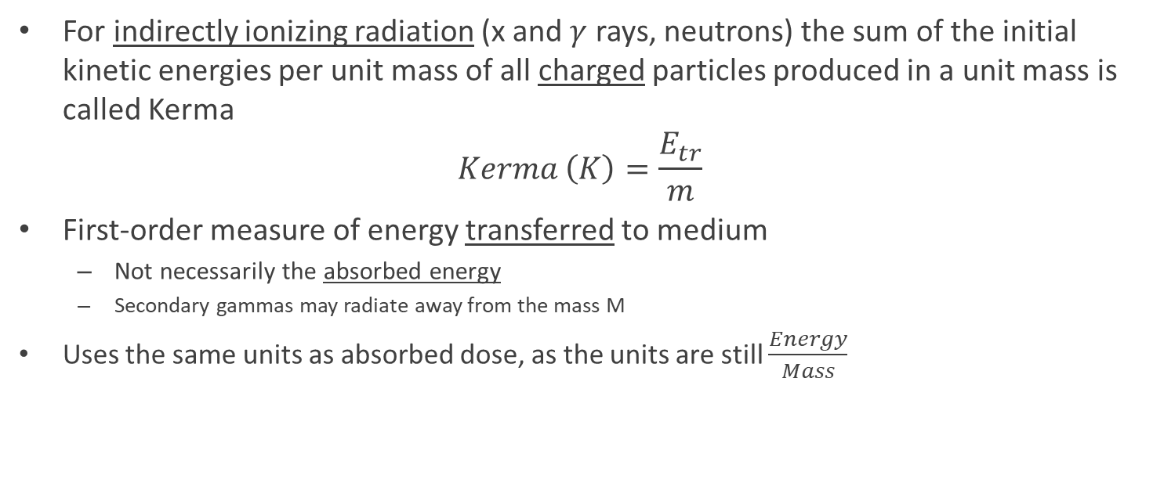
Kerma –
Kinetic Energy Released Per Unit Mass
For indirectly ionizing radiation (x and $γ$ rays, neutrons) the sum of the initial kinetic energies per unit mass of all charged particles produced in a unit mass is called Kerma
$$Kerma \left(K\right)=\frac{E_{tr}}{m}$$
First-order measure of energy transferred to medium
  Not necessarily the absorbed energy
  Secondary gammas may radiate away from the mass M
Uses the same units as absorbed dose, as the units are still $\frac{Energy}{Mass}$

Slide 31
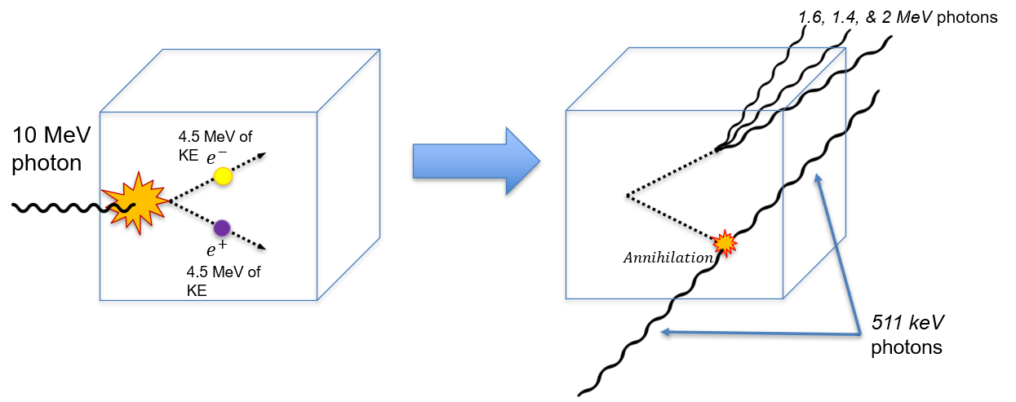
Kerma Example Problem
A 10 MeV photon penetrates a 100 g mass. Pair production gives an e+, e- pair, each of 4.5 MeV. Their energy is dissipated within the mass via ionization and bremsstrahlung.
Three Bremsstrahlung photons of 1.6, 1.4, and 2 MeV each are produced, but don’t interact and escape the mass.
After the e⁺ loses all its kinetic energy, it interacts with an e⁻, annihilates, and produces two 0.511 MeV photons which also escape without interacting.
What’s the kerma and the absorbed dose?
M_{cube} = 100 g

Slide 32
Answer
Kerma (sum of the initial kinetic energies per unit mass of all charged particles produced by the radiation)
Absorbed dose (energy absorbed per unit mass)

Slide 33
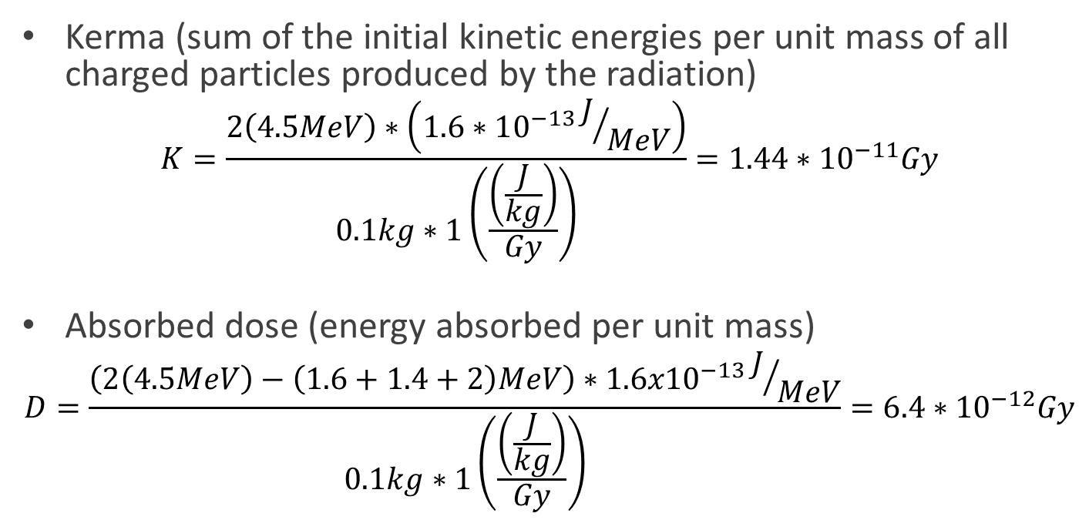
Answer
Kerma (sum of the initial kinetic energies per unit mass of all charged particles produced by the radiation)
$$K=\frac{2\left(4.5MeV\right)∗\left(1.6∗10^{−13}J/{MeV}\right)}{0.1kg∗1\left(\frac{\left(\frac{J}{kg}\right)}{Gy}\right)}=1.44∗10^{−11}Gy$$
Absorbed dose (energy absorbed per unit mass)
$$D=\frac{\left(2\left(4.5MeV\right)−\left(1.6+1.4+2\right)MeV\right)∗1.6x10^{−13}J/{MeV}}{0.1kg∗1\left(\frac{\left(\frac{J}{kg}\right)}{Gy}\right)}=6.4∗10^{−12}Gy$$

Slide 34
The Rem: Biological Effect
1 Rem = 1 Rad uniform, whole body gamma irradiation
Usually pegged to some negative outcome (typically fatal cancers)
Rem can refer to three quantities:
  Equivalent dose
    How damaging is the type of radiation?
      Fxn of Linear Energy Transfer
  Effective dose
    How radiosensitive is the impacted organ?
  Effective dose equivalent
    The sum of all effective doses across all tissues

Slide 35

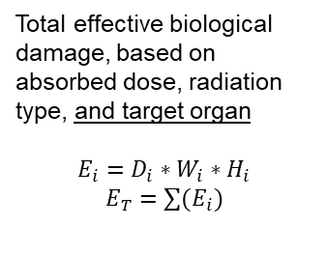

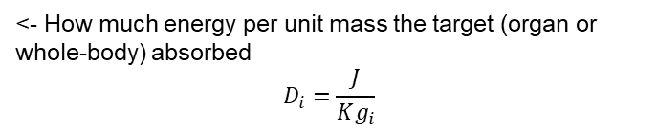
Subscript T indicates specific tissue,
Subscript R indicates radiation
Subscript Total indicates whole-body
Subscript i indicates you can go for whole-body or organ
<- How much energy per unit mass the target (organ or whole-body) absorbed
$$D_{i}=\frac{J}{Kg_{i}}$$
How damaging the type of radiation is
$$H_{i}=D_{i}∗W_{R}$$
$$W_{R}>1 for α,η$$
$$W_{R}=1 for γ, β$$
Total effective biological damage, based on absorbed dose, radiation type, and target organ
$$E_{i}=D_{i}∗W_{i}∗H_{i}$$
$$E_{T}=∑(E_{i})$$
Measure of how much radioactive material is present
$$X=\frac{q}{m_{air @ STP}}$$
^ “Objective” measure of radiation produced, independent of target

Slide 36
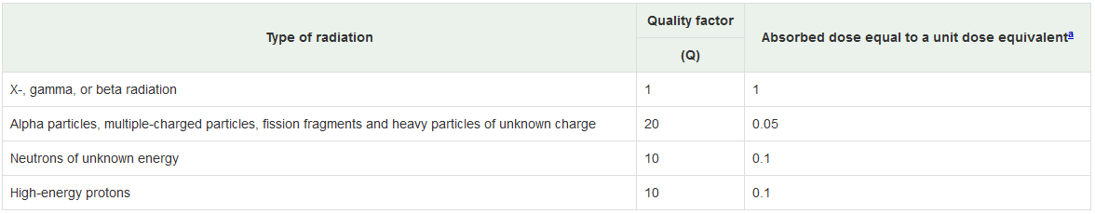
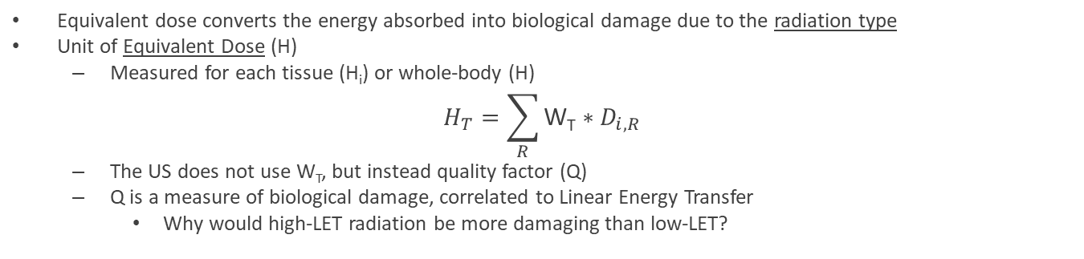
The Rem as Equivalent Dose
Equivalent dose converts the energy absorbed into biological damage due to the radiation type
Unit of Equivalent Dose (H)
  Measured for each tissue (H_{i}) or whole-body (H)
$$H_{T}=\sum_{R}{\text{W}\text{T}∗D_{i,R}}$$
  The US does not use W_{T}, but instead quality factor (Q)
  Q is a measure of biological damage, correlated to Linear Energy Transfer
    Why would high-LET radiation be more damaging than low-LET?
10 CFR 20.1004:
Quality Factors and Absorbed Dose Equivalents

Slide 37
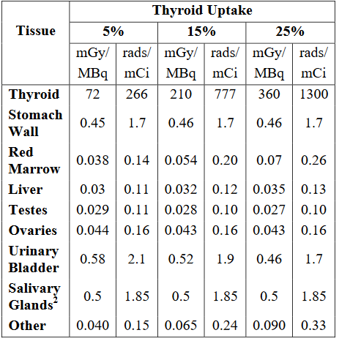
The Rem as Effective Dose
Consider the case of Iodine-131 uptake (1mCi, injected)
  I-131 tends to accumulate in the thyroid
  Beta Particles travel a few mm at most in tissue
  Thus, most energy is deposited in the thyroid
Does 777 rads to the thyroid behave like 777
rads to another organ or the bone marrow?

Slide 38
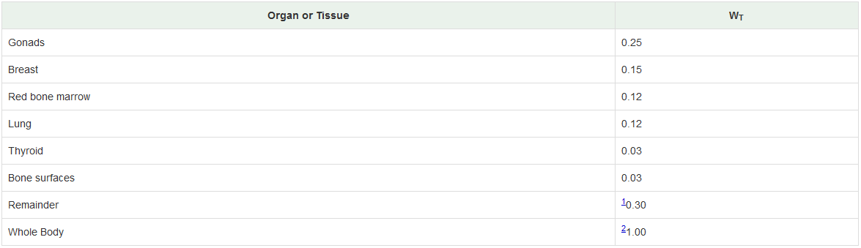
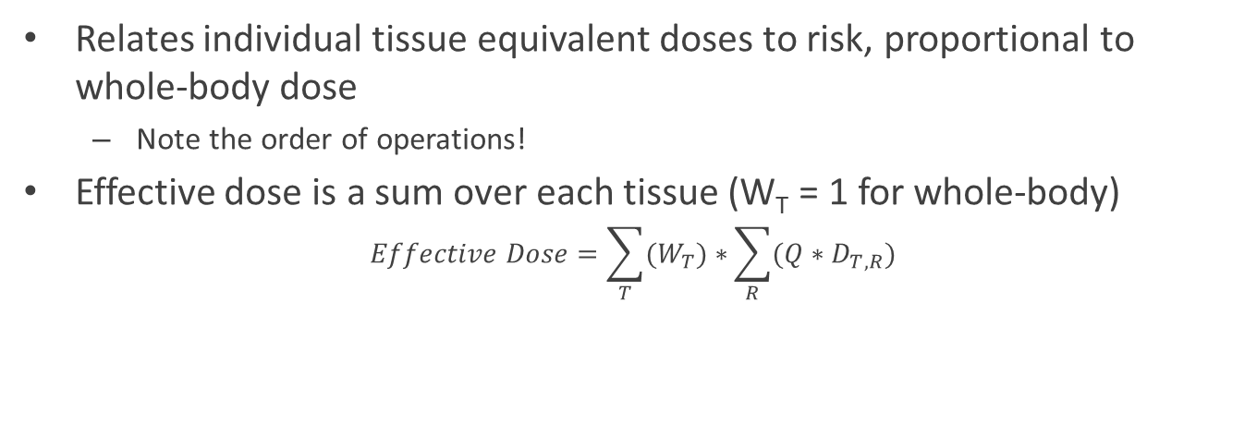
The Rem: Effective Dose
Relates individual tissue equivalent doses to risk, proportional to whole-body dose
  Note the order of operations!
Effective dose is a sum over each tissue (W_{T} = 1 for whole-body)
$$Effective Dose=\sum_{T}{(W_{T})∗}\sum_{R}{(Q∗D_{T,R})}$$
US NRC
10 CFR 20.1003 ->

Slide 39
Intro to Internal Dosimetry
So far, we have dealt with radiation that originates from outside the body
What happens if you were to eat/inhale a radioactive source?
  Contaminated crops/milk
  Inhalation of radioactive particles/gases

Slide 40
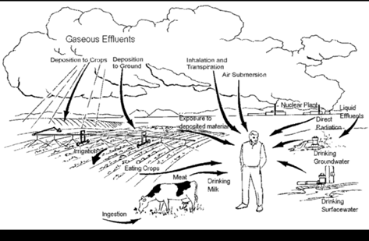

Slide 41
Uptake of Radiological Material
The body may uptake inhaled or consumed radiological material
  Depending on chemical properties, the body may incorporate this material into tissue
For long half-life radionuclides, this may result in being dosed for decades
  E.g. ¹³⁷Cs incorporated into bones
However, if the body rapidly uses and excretes the material, the radiological half-life may not matter
  ³H has a 12-year half-life, but body concentrations of tritium are halved in 10 days
This turnover in material is referred to as Biological Half-Life

Slide 42
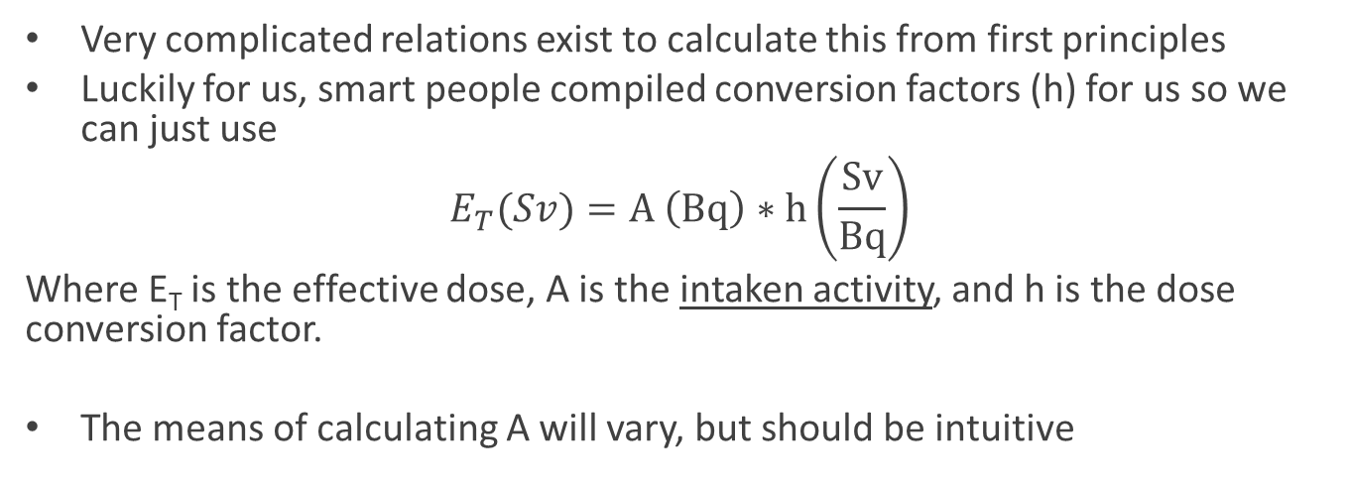
Internal Dosimetry Calculations
Very complicated relations exist to calculate this from first principles
Luckily for us, smart people compiled conversion factors (h) for us so we can just use
$$E_{T}(Sv)=A \left(Bq\right)∗h\left(\frac{Sv}{Bq}\right)$$
Where E_{T} is the effective dose, A is the intaken activity, and h is the dose conversion factor.
The means of calculating A will vary, but should be intuitive

Slide 43
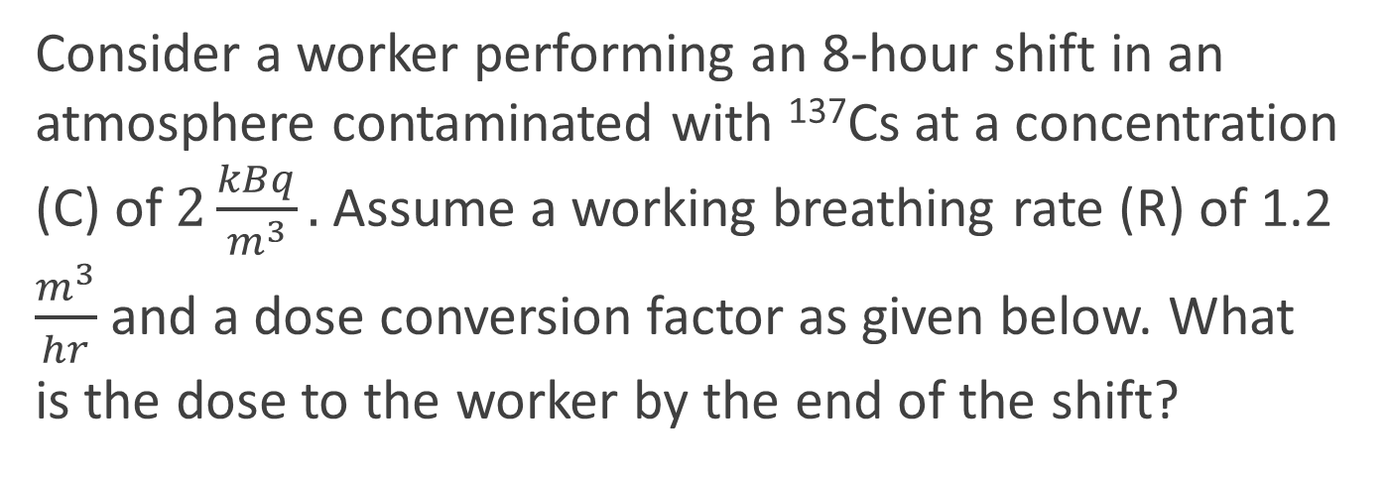
Sample Internal Dosimetry Calculation
Consider a worker performing an 8-hour shift in an atmosphere contaminated with ¹³⁷Cs at a concentration (C) of $2\frac{kBq}{m^{3}}.$ Assume a working breathing rate (R) of 1.2 $\frac{m^{3}}{hr}$ and a dose conversion factor as given below. What is the dose to the worker by the end of the shift?

Slide 44

Sample Internal Dosimetry Calculation
$$We are given R=1.2\frac{m^{3}}{hr}, C=2,000\frac{Bq}{m^{3}}, h=1.35E\text{−}8\frac{Sv}{Bq}, t=8 hours$$

Slide 45
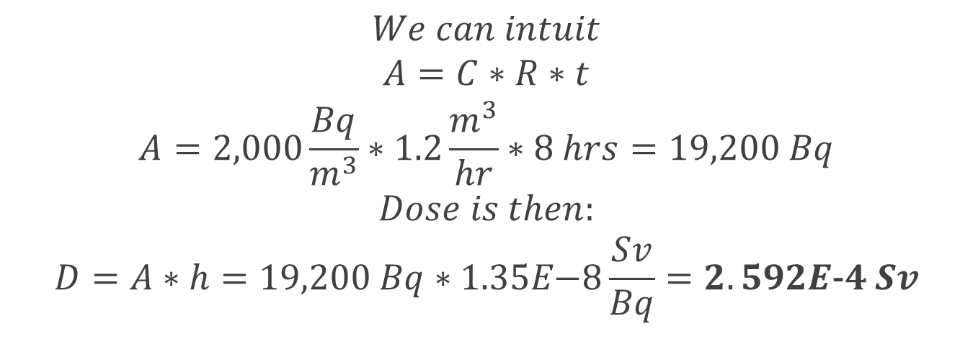
Sample Internal Dosimetry Calculation
$$We can intuit$$
$$A=C∗R∗t$$
$$A=2,000\frac{Bq}{m^{3}}∗1.2\frac{m^{3}}{hr}∗8 hrs=19,200 Bq$$
$$Dose is then:$$
$$D=A∗h=19,200 Bq∗1.35E\text{−}8\frac{Sv}{Bq}=2.592E\text{−}4 Sv$$

Slide 46
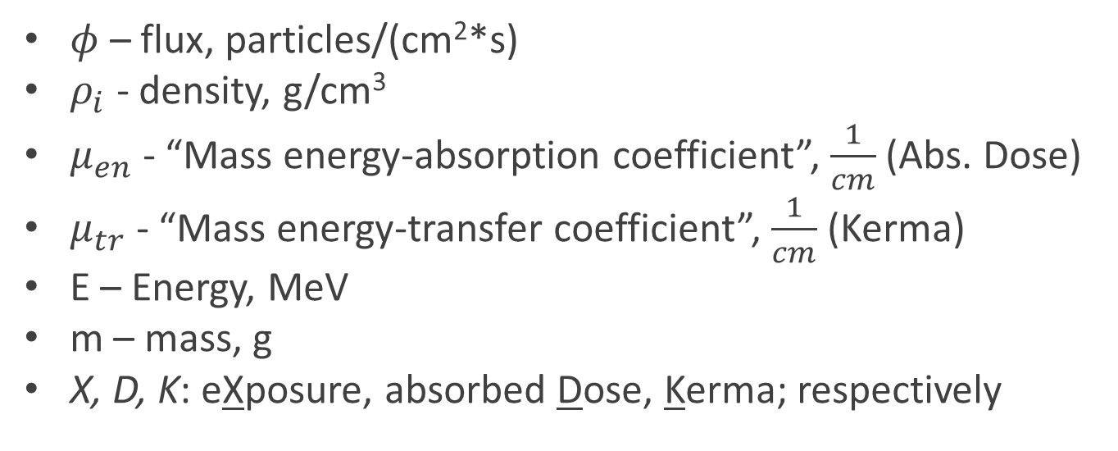
Some symbols in external dosimetry & typical units:
$φ$ – flux, particles/(cm²*s)
$ρ_{i}$ - density, g/cm³
$μ_{en}$ - “Mass energy-absorption coefficient”, $\frac{1}{cm}$ (Abs. Dose)
$μ_{tr}$ - “Mass energy-transfer coefficient”, $\frac{1}{cm}$ (Kerma)
E – Energy, MeV
m – mass, g
X, D, K: eXposure, absorbed Dose, Kerma; respectively

Slide 47
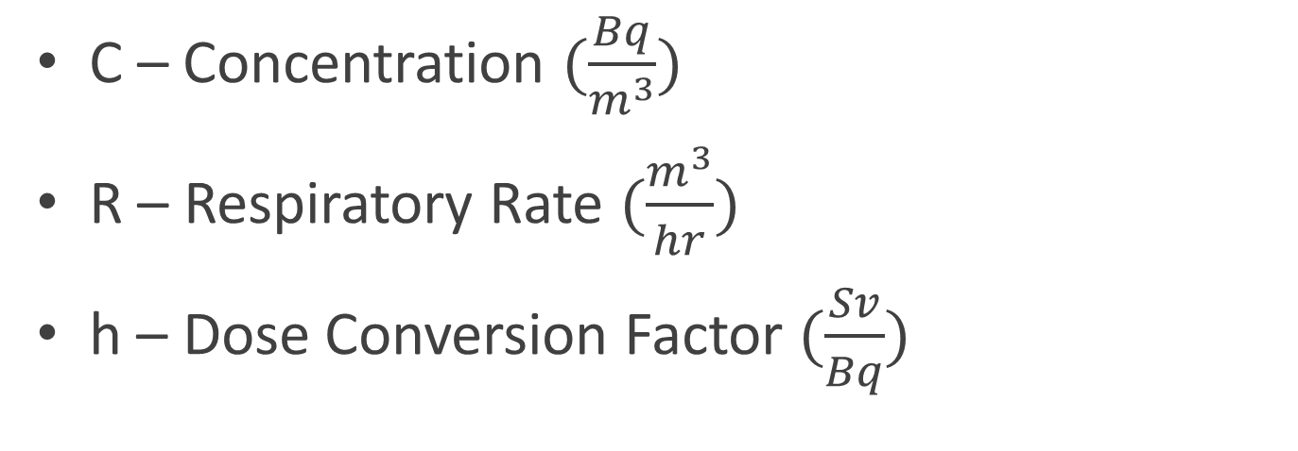
Symbols in Internal Dosimetry & Typical Units
C – Concentration $(\frac{Bq}{m^{3}})$
R – Respiratory Rate $(\frac{m^{3}}{hr})$
h – Dose Conversion Factor $(\frac{Sv}{Bq})$

